Slide 1



SIMERP
Wellness & Health Integrated Preventive-Care Program

Slide 2


ABOUT US
We present to you an employer sponsored program with the goal of empowering companies to provide their employees with comprehensive health beneﬁts while maximizing savings. By leveraging tax incentives we enable businesses to allocate savings towards health premiums, fostering a healthier workforce and a thriving workplace environment. Our Wellness approach ensures regulatory compliance, ﬁnancial efﬁciency, and employer/ employee satisfaction making Sequoia the partner of choice for forward thinking businesses.

Slide 3




PROGRAM ELIGIBILITY
Must be W2 employee
Work at least 30 hours/week and ﬁnancially qualify
Must have health insurance in place, if not receive a MEC(Minimum Essential Coverage) Plan

Slide 4
ITS A WIN FOR EVERYONE!
EMPLOYER FEATURES
Lower payroll taxes by an average of $630 annually per employee. Decrease the incidence of Work Compensation claims typically reported on Monday mornings, which represent 70% of total claims. Achieve up to a 30% reduction in Worker's Compensation costs while maintaining your current broker and policy.
EMPLOYEE FEATURES
Every employee gains access to a preventative care beneﬁt package that is accessed through our wellness app. Our technology is a medium between you and healthcare professionals. Setting up appointments and ﬁnding new doctors that are accommodating to your schedule and needs is now as easy as a push of a button.
Guaranteed issue policies for accident, disability, critical illness including cancer, dental, hospital indemnity,
vision and whole life insurance are provided to employees without the need for health qualiﬁcations. Access to coverage and resources is
available without impacting their net pay.
HUMAN RESOURCE FEATURES
Compatible with all payroll companies for seamless integration. The technology ensures peak efﬁciency with minimal effort required from HR, payroll, and team members. Offers premium concierge service, including a dedicated client service manager for personalized assistance.

Slide 5
ALLOTMENT ESTIMATE
REDUCTIONS AND SAVINGS
Number of
employees
Monthly allotment per employee
Annual allotment total
Company annual employee beneﬁts
Number of
employees
Monthly reduction per employee
Company annual grpayrolloss reductions
FICA
tax savings
100
$203.08
$2,436.96
$243,696
100
$1,216
$14,592
$63,000
500
$203.08
$2,436.96
$1,218,480
500
$1,216
$14,592
$315,000
1,000
$203.08
$2,436.96
$2,436,960
1,000
$1,216
$14,592
$630,000

Slide 6
HOW DOES THIS WORK?
Internal Revenue Codes
Explanation
Section §125 allows for pre tax deductions on certain
health related beneﬁts
Pre tax Deduction
§ 125. Cafeteria plans
General rule Except as provided in subsection
, no amount shall be included in the gross income of a participant in a cafeteria plan solely because, under the plan, the participant may choose among the beneﬁts of the plan.
§106
Contributions by employer to accident and health plans (a) General rule Except as otherwise provided in this section, gross income of an employee does not include employer-provided coverage under an accident or health plan.
§213 d
for the diagnosis, cure, mitigation, treatment, or prevention of disease, or for the purpose of affecting any structure or function of the body.
Exclusion from income
Through §106 (a) the amount of the deduction or premium of the health plan being offered, in this case Wellness, is excluded from gross income therefore allowing you to lower your taxable income and create savings.
Compliance
§213 (d) provides us with the categories that are eligible for reimbursements and criteria for total compliance. A wellness plan falls under preventative care, which is within the categories mentioned.

Slide 7
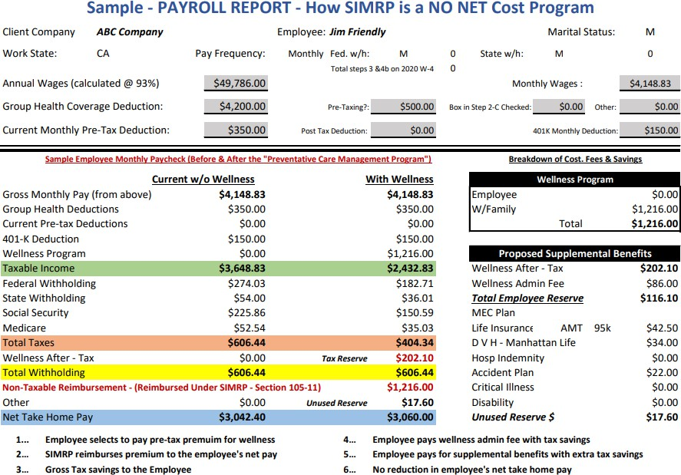

Slide 8
Internal Revenue Codes
Explanation
Pairing §105 and SIMRP, which functions as a form Health Reimbursement Arrangement allows for a reimbursement of the costs used towards said health expense or premium.
Reimbursement
§1.105.11 SIMRP A Self Insured Medical Reimbursement
Plan is a separate written plan for the beneﬁt of the employees which provides for reimbursement of employee medical expenses referred to in section 105(b).
§ 105(b)
Amounts received under accident and health plans
(b) Amounts expended for medical care Except in the case of amounts attributable to (and not in excess of) deductions allowed under section
213 (relating to medical, etc., expenses) for any prior taxable year, gross income does not include amounts referred to in subsection.
§104(a)(3)
Amounts received through accident or health insurance (or through an arrangement having the effect of accident or health insurance) for personal injuries or sickness (other than amounts received by an employee, to the extent such amounts (A) are attributable to contributions by the employer which were not includible in the gross income of the employee.
The allotment stems from the tax savings created. This can be used towards health premiums such as critical illness, hospital, dental, vision, life insurance, accidental.
Under 104(a)(3) amounts received through
accident or health insurance for personal injuries or sickness are generally not included in gross income which also applies if the insurance premiums were paid with after-tax dollars. Therefore any payment received on these policies would not be subjected to taxing.
Allotment

Slide 9
SUPPLEMENTAL BENEFITS FOR ALLOTMENT
Type of Policy
Description
Monthly Premium
Personalize your own beneﬁts package according to your needs using allotted savings dollars, no out of pocket cost.
Type of Policy
Description
Monthly Premium
Critical Illness including cancer
This critical illness policy provides coverage with guaranteed acceptance for internal cancer, heart attack, stroke, kidney failure, etc. Receive $10,000 after diagnosis.
$20.00
Hospital
A hospital policy that initially offers $750
after the ﬁrst 24 hours hospitalized and
$100 per extra day in there. In the case of surgery it offers $500 for inpatient procedures and $250 for outpatient.
$40.50
Vision
This policy covers eye exams, eye refraction, including the cost of eye glasses or contact lenses
$33.15
Short Term Disability
State disability only provides around 55% of your usual paycheck. This policy can top you up to nearly 72% of your gross income, the highest percentage allowed. This can increase your pay up to $600 more each month if you're unable to work because of an injury or illness that happens off the job.
$25.00
Dental
This policy covers semi- annual exams, cleaning and x-rays
$33.15
Accident
In the case of accident you would get
$2,000 on the ﬁrst 24 hours of hospitalization, then $500 for each day you're in the hospital and double the amount for Intensive Care. This also covers surgery, emergency room visits, ambulance rides, and more.
$23.12
Life insurance
This is a whole life guaranteed issue life insurance policy. Your family can get up to $100,000
$65.30

Slide 10
STEPS TOWARDS ENROLLMENT
Qualiﬁcation process
Client submits employee W2 and W4 form of the last two months of payroll
Our underwriting team qualiﬁes and reviews documents for employee census
Accounting department runs calculations to determine savings
Our insurance professionals review the best plans for implementation
Program Set-Up/Contract
Instructions are given on how to set up program with payroll
Proposal provides potential tax savings for employer
Proposal provides individual allotment amounts for the employees.
Employer signs client document
Program Launch
Employer provides employees sponsorship letter
Employer provides email video explaining program
Enrollment dates are set
All employees sign to participate or not participate
Payroll Savings
Payroll tax savings are realized upon each payroll run
FICA tax savings for employer
Plan Admin
Wellness program fee is paid monthly billed in arrears
Supplemental carriers are paid end of month
All fees are paid for with tax savings.

